Slide 1
Automatic Wiper ECU
Name: Tanase Silviu Ionut
Date: 10.10.2023

Slide 2
Introduction
The primary objective of this project is to showcase the simulation of an Automatic Wiper ECU system using an Arduino Uno board. This ECU system is commonly found in modern vehicles to automatically adjust wiper speed based on rain intensity.
Utilizing basic electronic components such as potentiometers and LEDs, I've recreated a simplified version of this intricate system. The potentiometer simulates varying rain levels, which the Arduino processes to command the wiper (represented by a blinking LED) and to indicate wiper speed (represented by a series of four LEDs).

Slide 3
Project Requirements
Input:
Potentiometer to simulate rain intensity.
Output:
1 LED representing the wiper's operational status (on/off cycle).
4 LEDs representing the wiper's speed levels, mapped from 10% to 100%.
Functionality & Requirements:
Wiper Operational Status (1 LED):
Activates if Rain Intensity ≥ 20%. Indicates the on-off cycle based on the wiper's speed.
Wiper Speed Indication (4 LEDs):
Rain Intensity < 20%: All LEDs off.
Rain Intensity ≥ 20%: First LED on (representing 10% speed).
Rain Intensity > 90%: All LEDs on (representing 100% speed).
Rain Intensity between 20% and 90%: LEDs light up progressively in equal steps to indicate increasing speeds.

Slide 4
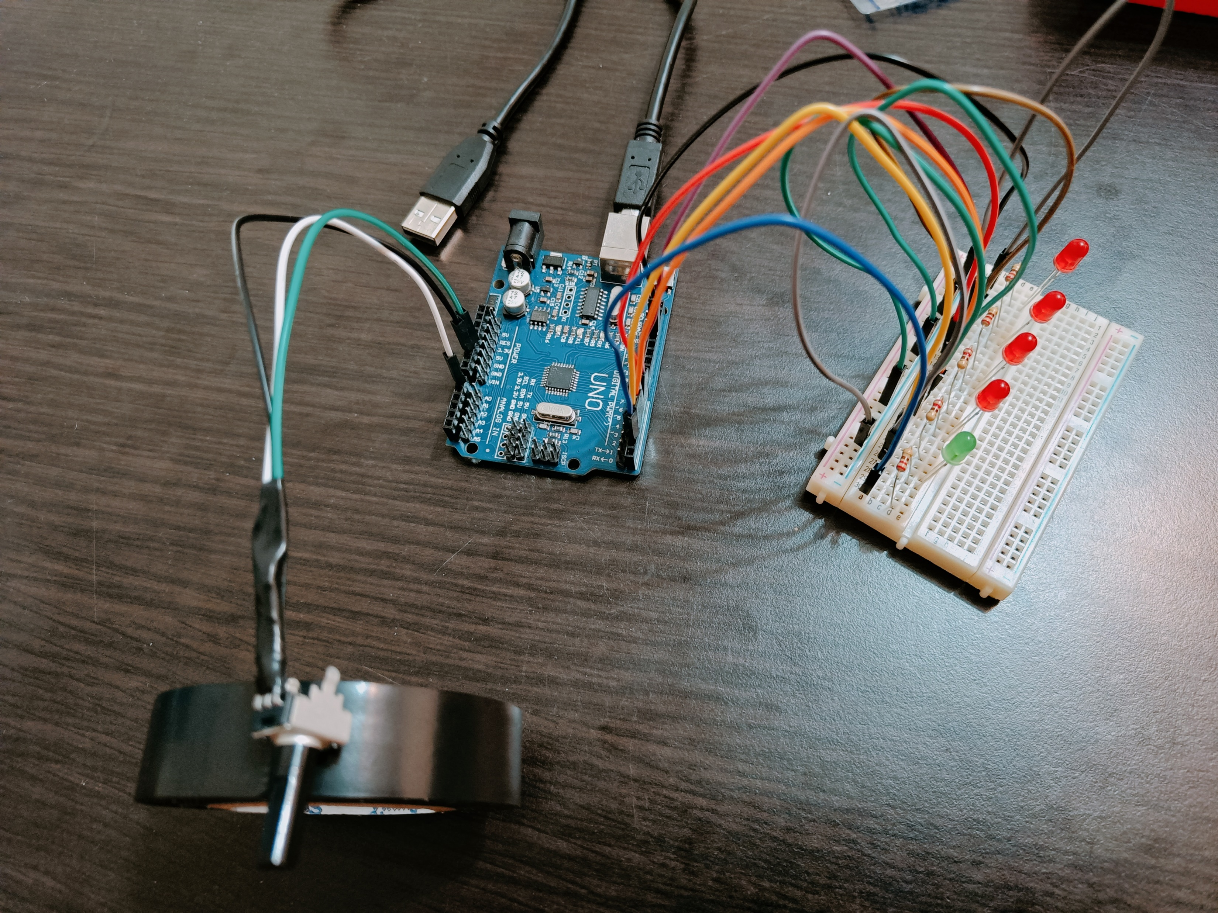
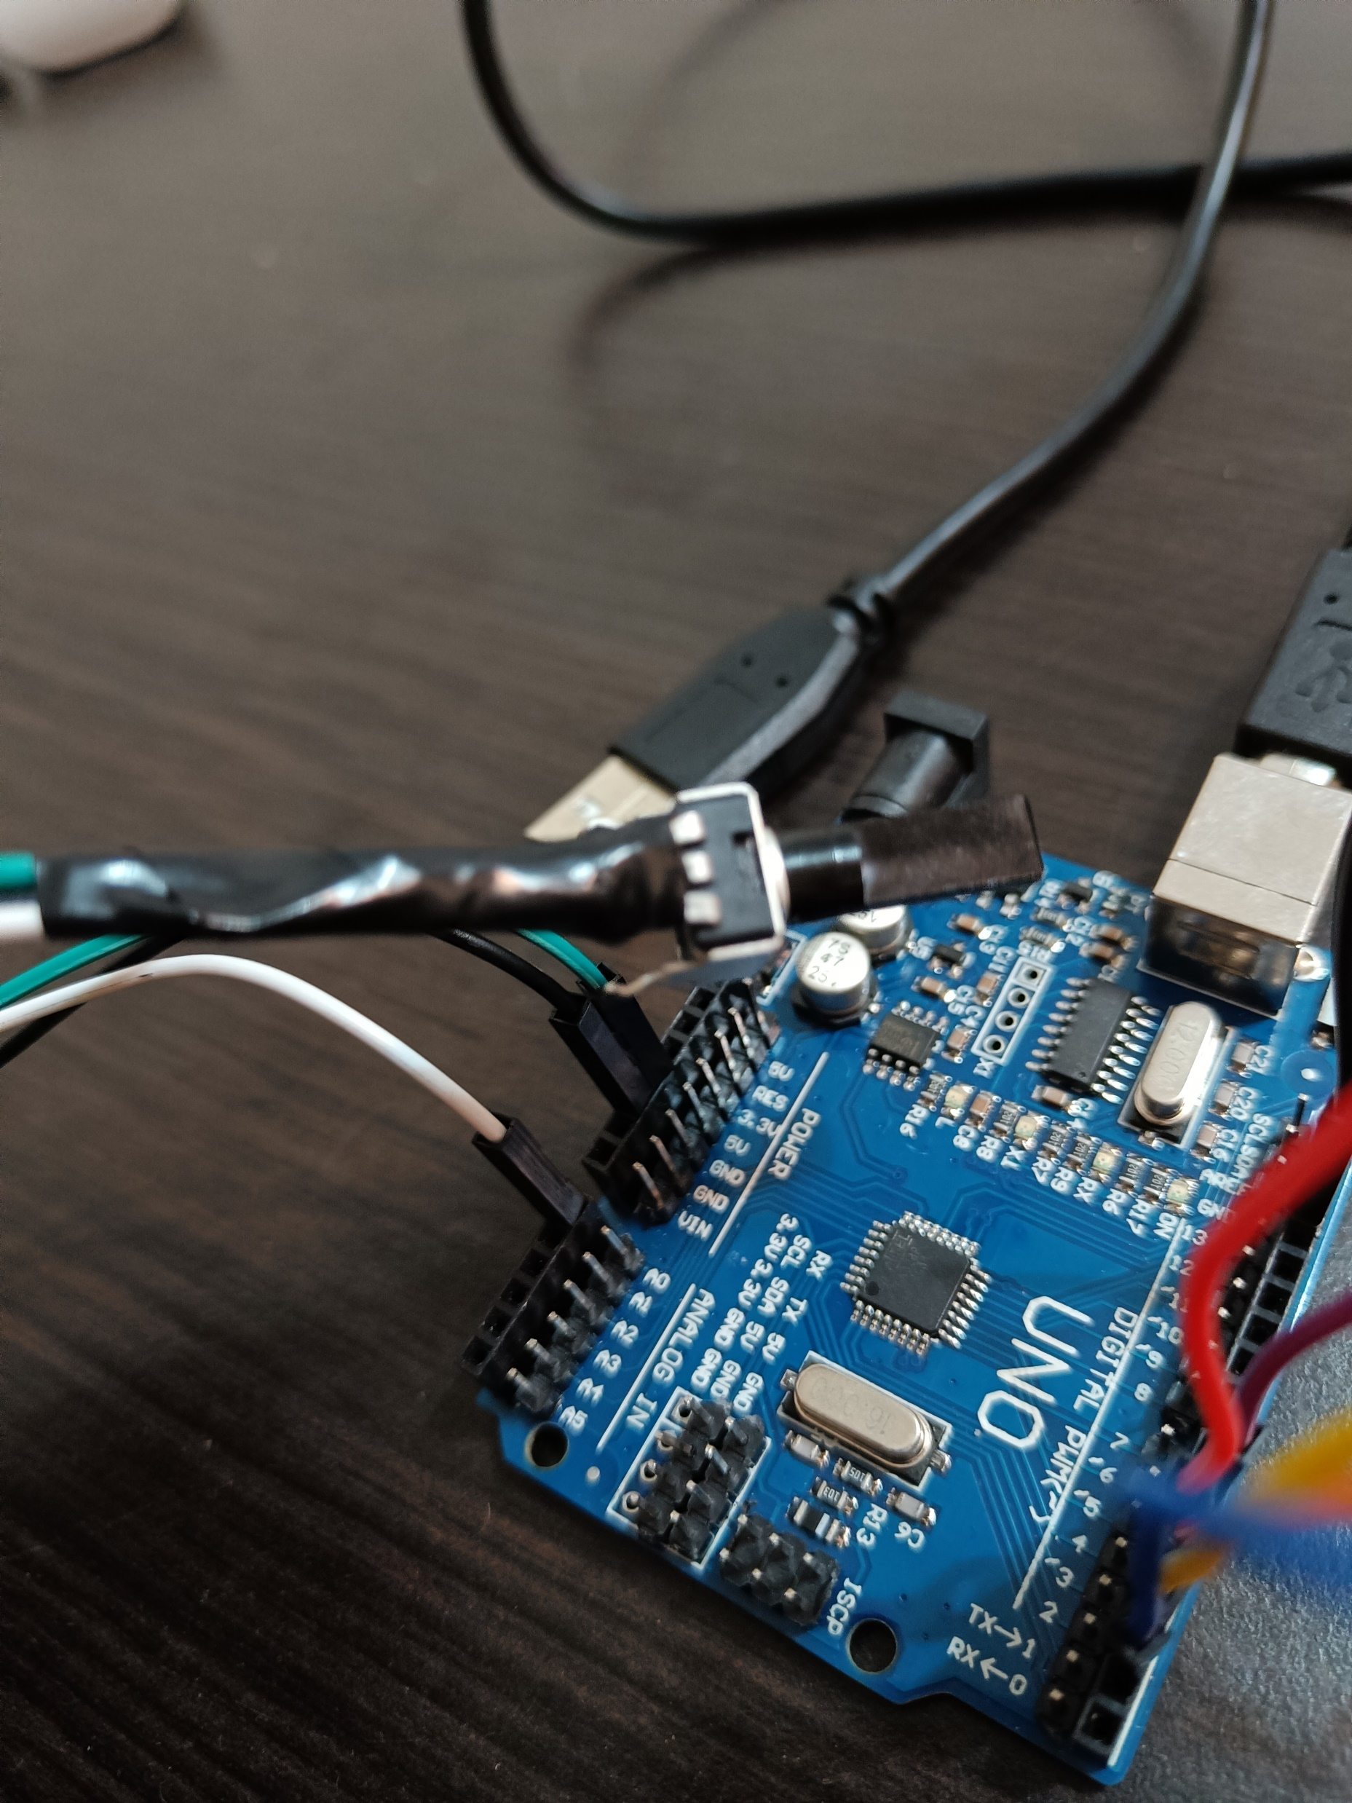
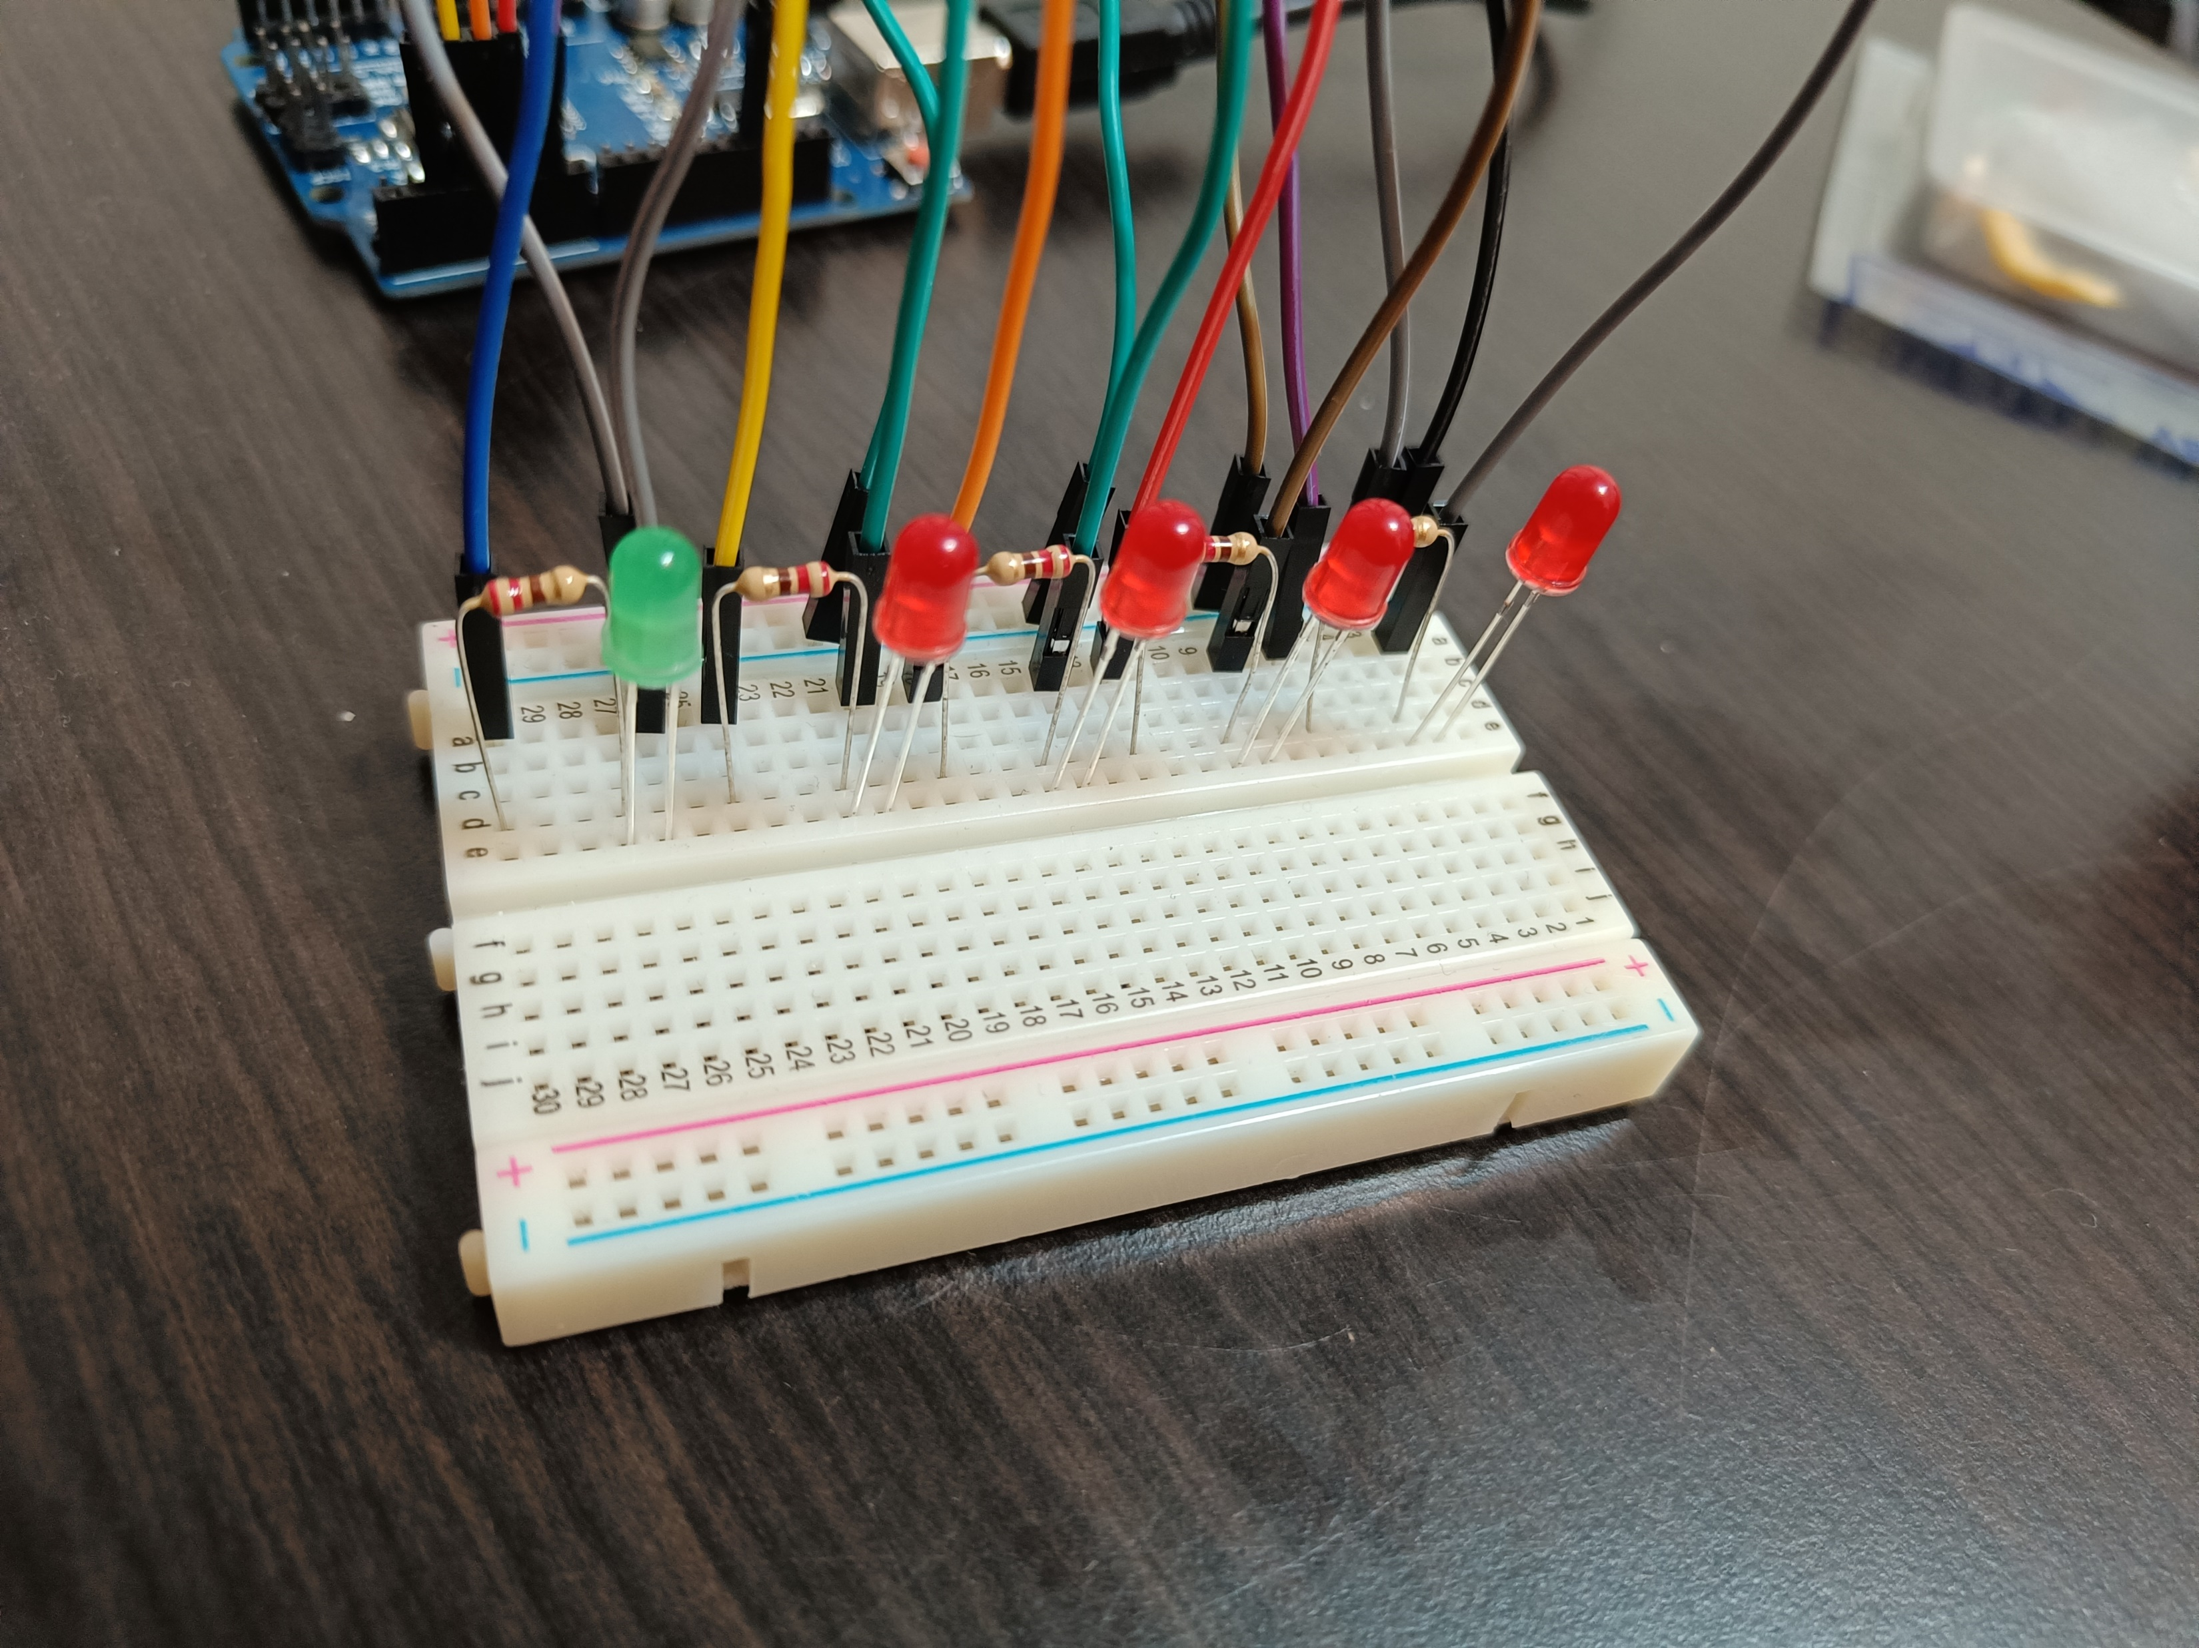
System Overview
Figure 1. Overall Setup
Figure 3. LEDs and connections
Figure 2. Potentiometer

Slide 5
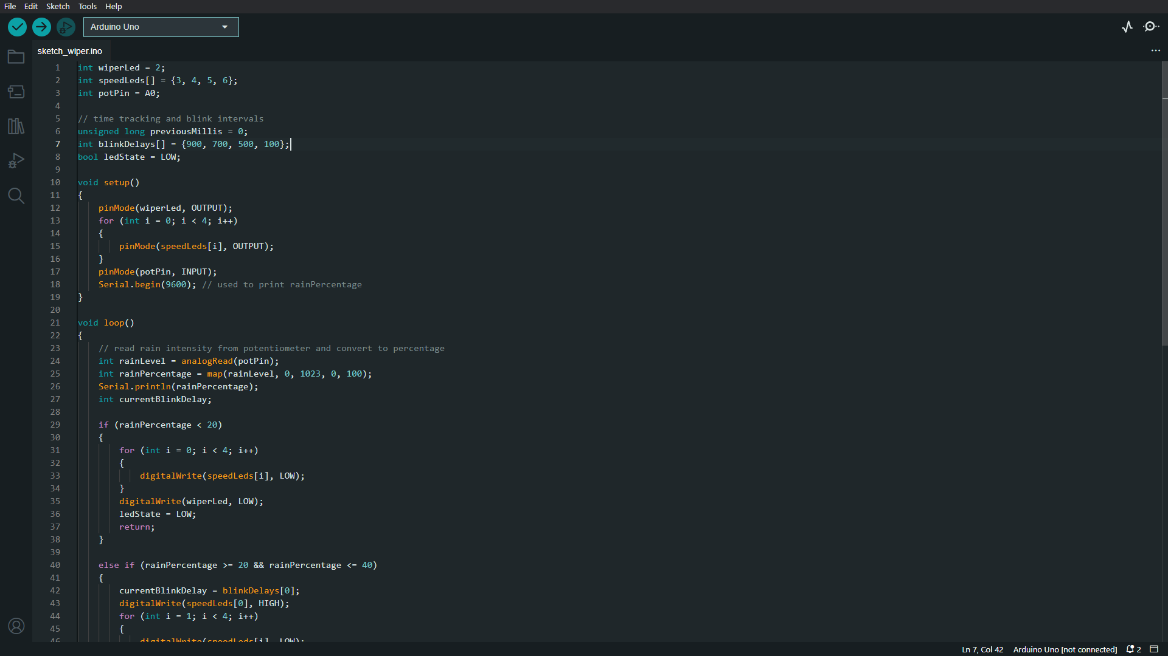
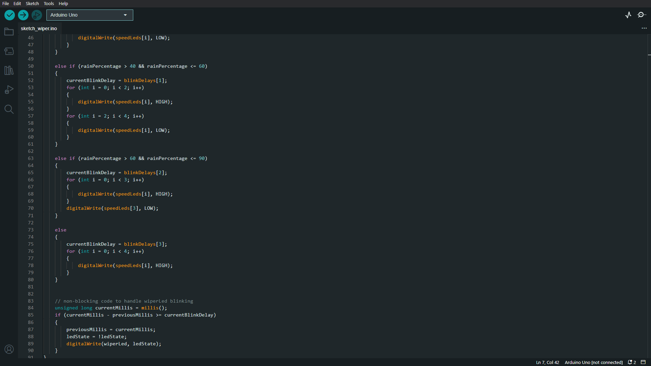
Code Implementation

Slide 6
